Slide 1
Presentation On E-Commerce
By – Group 4
Suman Jaiswal
Kanchan Chitnavis
Anandhu Nair
Kanchi Dave
Anuj Badoniya
Jeetu Gaikwad

Slide 2
Introduction
E-Commerce consists of the buying and selling of products or services over electronic systems such as the Internet and other computer network, consists of :
Buyers
Sellers
Producers

Slide 3
History Of eCommerce
Year | Event
1994 | Netscape Launch; SSL encryption enabled shopping.
1995 | Backbone of eCommerce formed; Amazon, eBay and Verisign launched.
1997 | Dell first company to reach @ 1Mn in online sale.
1998 | Google launched, USPS launched eStamps.
2000 | Dot-com bubble burst.
2002 | eBay acquired PayPal.
2003 | Facebook launched for students.
2006 | Google acquired YouTube. iTunes became 1st digital music retailer.
2007-08 | Private sales model, Social eCommerce, Mobile e-Commerce, Daily deals/local eCommerce.

Slide 4
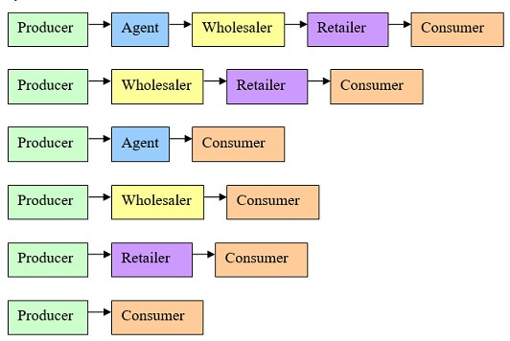
Traditional Shopping
What is traditional shopping?
Structure of traditional shopping

Slide 5
Challenges in Traditional Shopping
Travelling
Products availability
Product limitation
Physical atmosphere
Maintenance

Slide 6
Types Of E-Commerce
Business to Business (B2B)
Business to Government (B2G)
Consumer to Consumer (C2C)
Government to Consumer (G2C)
Government to Business (G2B)
Business to Consumer (B2C)

Slide 7
Business To Business (B2B)
B2B e-commerce is simply defined as ecommerce between companies.
About 80% of e-commerce is of this type.
Examples:
Intel selling microprocessor to Dell
Heinz selling ketchup to Mc Donalds

Slide 8

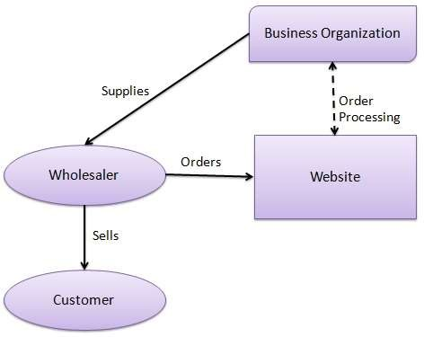
B2B Model

Slide 9

Business To Government (B2G)
Business-to-government e-commerce or B2G is generally defined as commerce between companies and the public sector.
Example: – Business pay taxes, file reports, or sell goods and services to Govt. agencies.
GeM – Government e-Marketplace.

Slide 10

B2G Model

Slide 11

Consumer To Consumer (C2C)
Consumer-to-consumer e-commerce or C2C is simply commerce between private individuals or consumers.
Example: – OLX, Quicker, Cars24

Slide 12

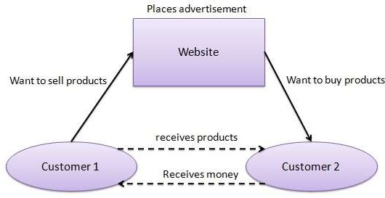
C2C Model

Slide 13

Government To Consumer(G2C)
This Model is also a part of e-governance.
The objective of this model is to provide good and effective services to each citizen.
The Government provides the following facilities to the citizens through website.
Information of all government departments,
Different welfare schemes,
Different application forms to be used by the citizens.

Slide 14

G2C Model

Slide 15
Government To Business (G2B)
Government-to-business (G2B) is a business model that refers to government providing services or information to business organization.
Government uses B2G model website to approach business organizations.
Such websites support auctions, tenders and application submission functionalities.

Slide 16


G2B Model

Slide 17

Business To Consumer (B2C)
Business-to-consumer e-commerce, or commerce between companies and consumers, involves customers gathering information; purchasing physical goods or receiving products over an electronic network.

Slide 18
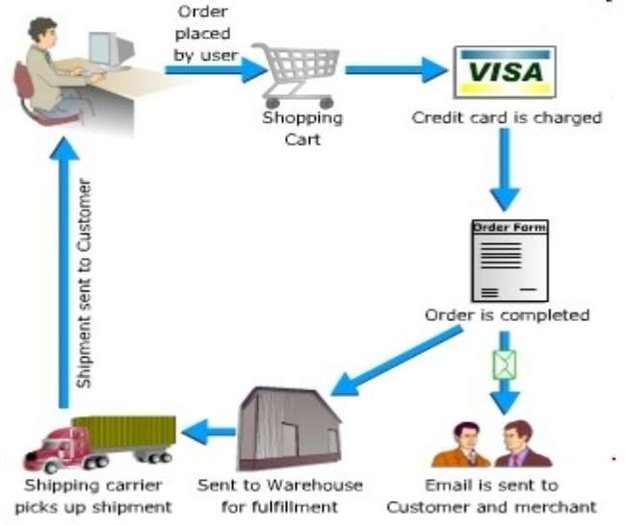
Process of Online Shopping

Slide 19
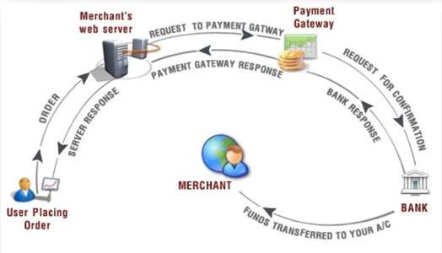
Payment Gateway

Slide 20
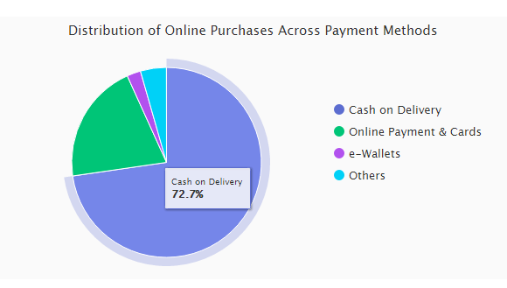
Methods of Payment
Credit Card
Debit Card
Payment Websites
Checks and Money Orders
Mobile Payments
Bank Transfer

Slide 21
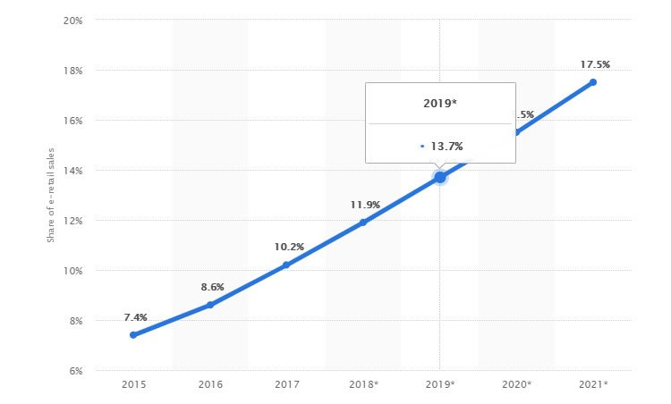
Global Statistics

Slide 22
Indian Statistics
Indian e-commerce market
Employment rate
Leading city in terms of Consumption
Region-wise distribution

Slide 23
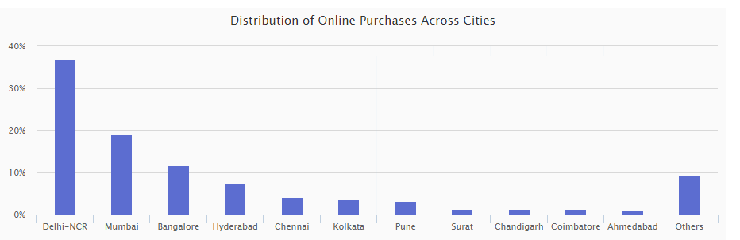
Indian Statistics (2019)

Slide 24
Rules and Regulation
Internationally there is the International Consumer Protection and Enforcement Network (ICPEN), which was formed in 1991 from an informal network of government customer fair trade organisations.
Asia Pacific Economic Cooperation (APEC) was established in 1989 with the vision of achieving stability, security and prosperity for the region through free and open trade and investment.

Slide 25
Consumer Protection Bill 2019
Rights of consumers:
Be protected against marketing of goods and services which are hazardous to life and property.
Be informed of the quality, quantity, potency, purity, standard and price of goods or services.
Be assured of access to a variety of goods or services at competitive prices.
Seek redressal against unfair or restrictive trade practices.

Slide 26
Consumer Protection Bill 2019
2. Central Consumer Protection Authority
3. Penalties for misleading advertisement
4. Consumer Disputes Redressal Commission
5. Jurisdiction of CDRCs
6. Product liability

Slide 27
Advantages of Online Shopping
Selection
In around-the-clock
Convenience
Information
Price and Offers
Availability

Slide 28
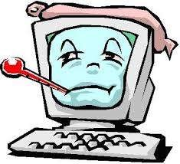
Disadvantages of Online Shopping
Hands-On Inspection
Shipping
Wait Time
Privacy
Fraud

Slide 29
Limitations
A never-ending wait for the product to arrive
No bargaining
Deceptive pictures
Makes you lazy
Deprives you of tangibility
Shipping costs

Slide 30
Challenges
Cash on Delivery
Location
Returns And Exchange
Online Payments
Law
False Orders

Slide 31
Conclusion
In the end we would like to conclude that-
The e-commerce has changed the relative importance of time, but as the pillars of indicator of the country’s economic state that the importance of time should not be ignored.

Slide 32
Thank you
Questions…..????

